Slide 1
Women Engineers and Entrepreneurs: Challenges and Opportunities while facing Lockdown
Ms. Yvette Ramos President Swiss Engineering Geneva Managing Director IP Law Firm Managing Director IP Law Firm
26 may 2020

Slide 2
“Extraordinary times call for
extraordinary measures.
As such, it can no longer be business as usual.”
Says the UN Secretary-General Antonio Guterres in his urgent call for special resources for the world's developing countries.

Slide 3
The NewYorkForum Institute, 19 may 2020

Slide 4
The NewYorkForum Institute, 19 may 2020

Slide 5
About WOMENVAI
a unique NGO founded by Women and Men Engineers and Scientists working together in:
Hightech for climate change adaptation
Equality education
Development aligned with the 2030 SDGs
Contributing more to development through networking,
Bringing our Experts in joint programs and projects around the world,
Presenting tools in strategic planning and leadership that can boost the developing institutions to be autonomous financially through private and public partnerships
Networking with multi-sectorial groups and organizations
Finally enjoying from a new experience online!

Slide 7
French Local NGO kicked-off 8 march 2020 for our female colleagues, friends and neighbours who suffer from special situations at home, at work etc.
Since lockdown started mid-March 2020, violences at home have increased (+ 32% in France). Majority of women continue (Source LeMonde.fr) to manage essential work at home, namely shopping, meals, homework, the garden, teachers, cleaning, etc.
We want to say STOP to Violence against women at home and develop CONNECT-3919 : a connected device that will allow, once identified, these women to be autonomous. CONNECT-3919 could be coupled to the home automation, which will alert the relevant public services and may send missing evidence to act legally against the attacker.
https://www.lespetitespierres.org/projets/covid-19-pour-quelles-sen-sortent-haute-savoie/548
www.instagram/larochepourelles

Slide 8
A call for special measures to promote social justice and gender equality in the response to the pandemic
Support the participation of women and gender specialists at all levels of policy and program development and the implementation of action plans.
Recognize and enhance the specific place of women in crisis management and in resilience to the crisis.
Prevent and deal with gender-based violence.
Consider services and care for sexual and reproductive rights and health essential.

Slide 9
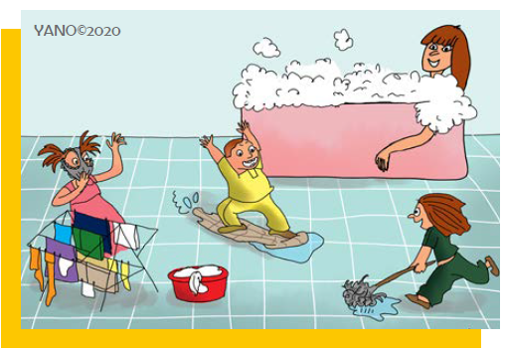
THANKS A LOT

